Slide 1
Email Transport Security in Practice
Email Client Selftest Service
Jhannes Ernesto Reimann, Sofya Generalova

Slide 2
Table of contents
Introduction
TLS in Email
TLS: Server and Client side
Current State of Email Security Testing
Vulnerability
Vulnerable servers (shodan)
Email Server Configuration Scanner
Vulnerable clients (study)
Selftest Service
Demo
Architecture
Challenges, Comparison to other Tools
Summary & Evaluation

Slide 3



TLS and Email protocols
TLS
TLS secures communication on the Internet: Encryption, Integrity, Authentication
HTTP VS HTTPS
Email uses its own dedicated protocols
To send emails: SMTP
To receive emails: IMAP or POP3
Email protocols with TLS: SMTPS, IMAPS, POP3S

Slide 4
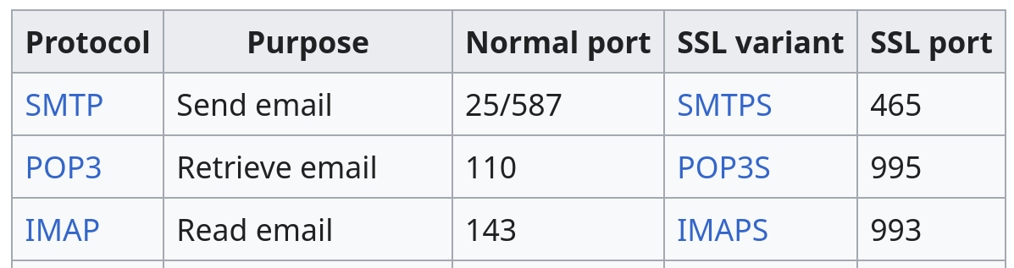
Original protocols communicate in plaintext
But: Upgrade to TLS-protected connection is possible via STARTTLS
Later secure protocol versions: implicit TLS support on dedicated ports

Slide 5
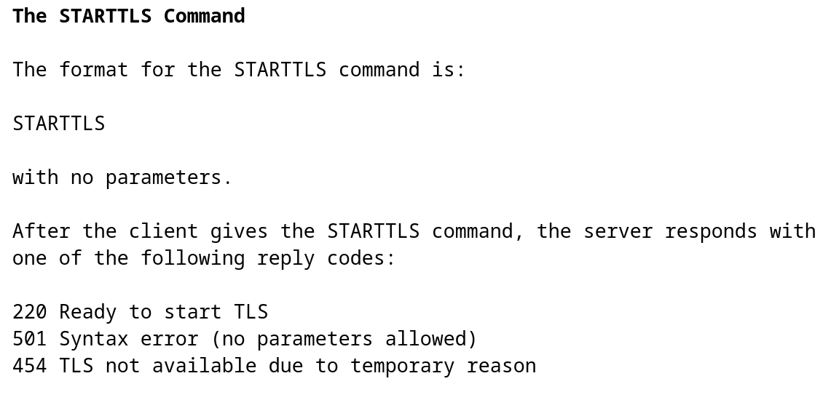
What is STARTTLS?
STARTTLS extension to SMTP/POP3/IMAP
An additional command that an email client can send during email protocol execution
Upgrades a plaintext SMTP/POP3/IMAP connection to a secure TLS connection
https://www.rfc-editor.org/rfc/rfc3207

Slide 6
Historical context
TLS support: two approaches
Implicit TLS
“Opportunistic” TLS
SMTPS:465
SMTP:587/25
POP3S:995
StartTLS
POP3:110
IMAPS:993
IMAP:143
Insecure!

Slide 7
TLS and Email in Practice: How to Configure an Email Server
SMTP Configuration with Postfix
Advice for email server admins:
1.Enable TLS-only port for client mail submission
File: /etc/postfix/master.cf
# Port 465 (Implicit TLS)
smtps inet n - y - - smtpd
-o syslog_name=postfix/smtps
-o smtpd_tls_wrappermode=yes
-o smtpd_sasl_auth_enable=yes
2.Often support for legacy ports is needed, ensure TLS is enforced
File: /etc/postfix/master.cf
# Port 587 (STARTTLS) submission inet n - y - - smtpd # -o smtpd_tls_security_level=may # -o smtpd_tls_auth_only=no
-o smtpd_tls_security_level=encrypt -o smtpd_tls_auth_only=yes

Slide 8
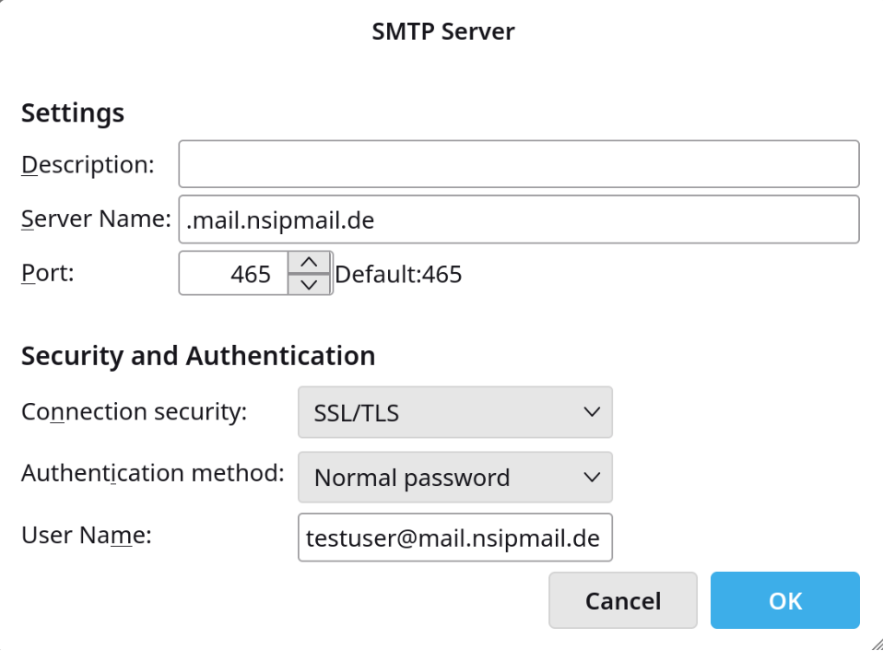
TLS and Email in Practice: Client-Side perspective
In Thunderbird:
Usually Email Clients automatically suggest TLS configuration
Advice to users:
Use secure email clients
Example: Microsoft Outlook mail client only supports SMTPS
Do not change TLS settings with no good reason
Problem: Users do not control how email clients enforce TLS internally
A client may: fall back to insecure connection on disruption, automatically apply insecure options with autodetection mechanism

Slide 9
TLS and Email in Practice: Server and Client Side
Summary
Email Server Admins should:
Allow Email clients to submit mail on TLS-only port
For legacy ports enforce TLS-only connections
Email Users should:
Select trusted Email Clients
-> Email Server Configuration Scanner for admins
-> Email Client Selftest Service for users

Slide 10
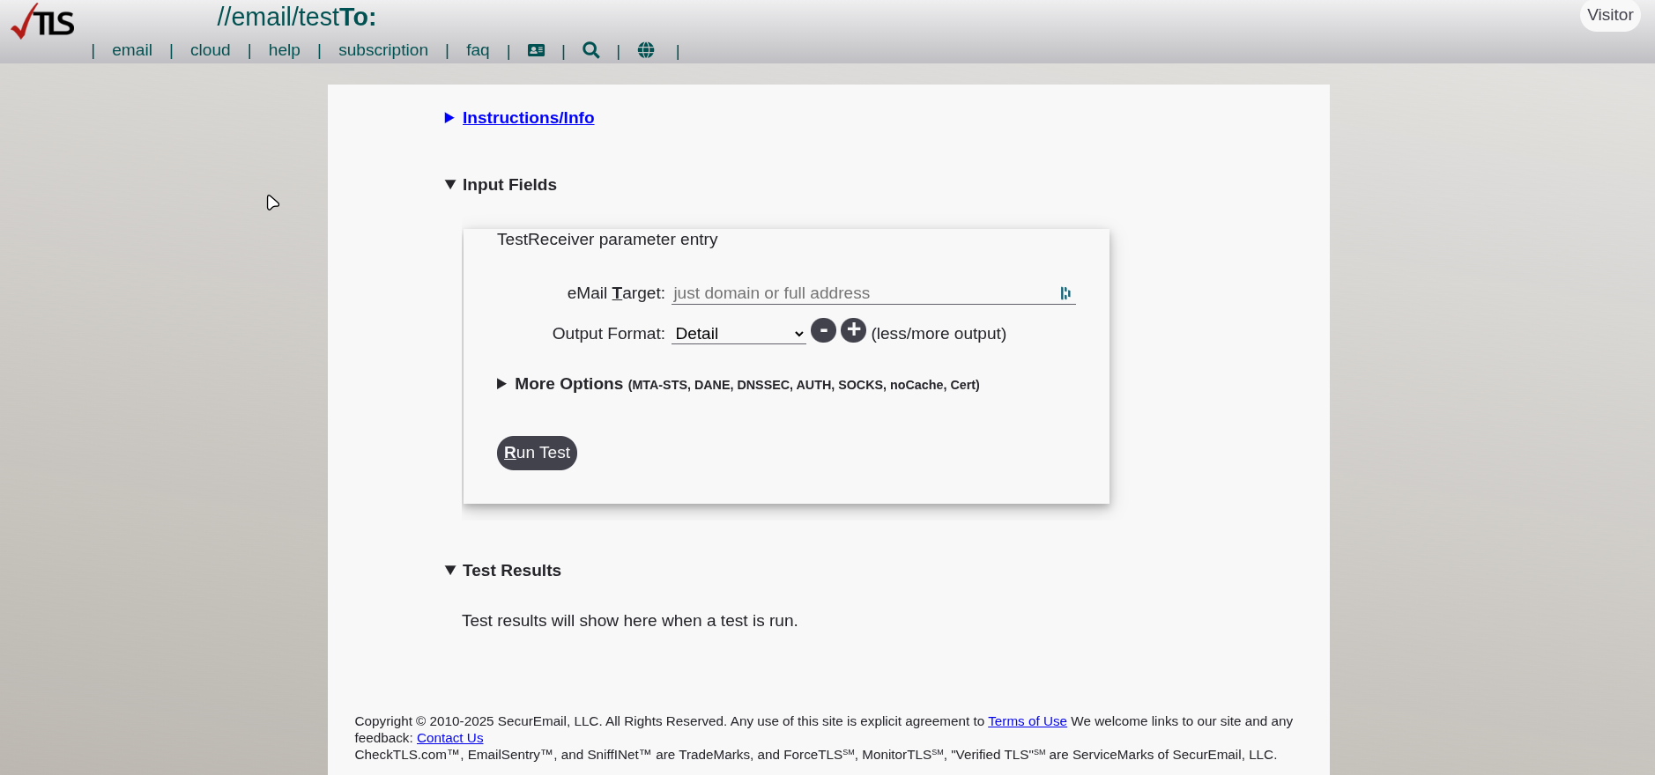
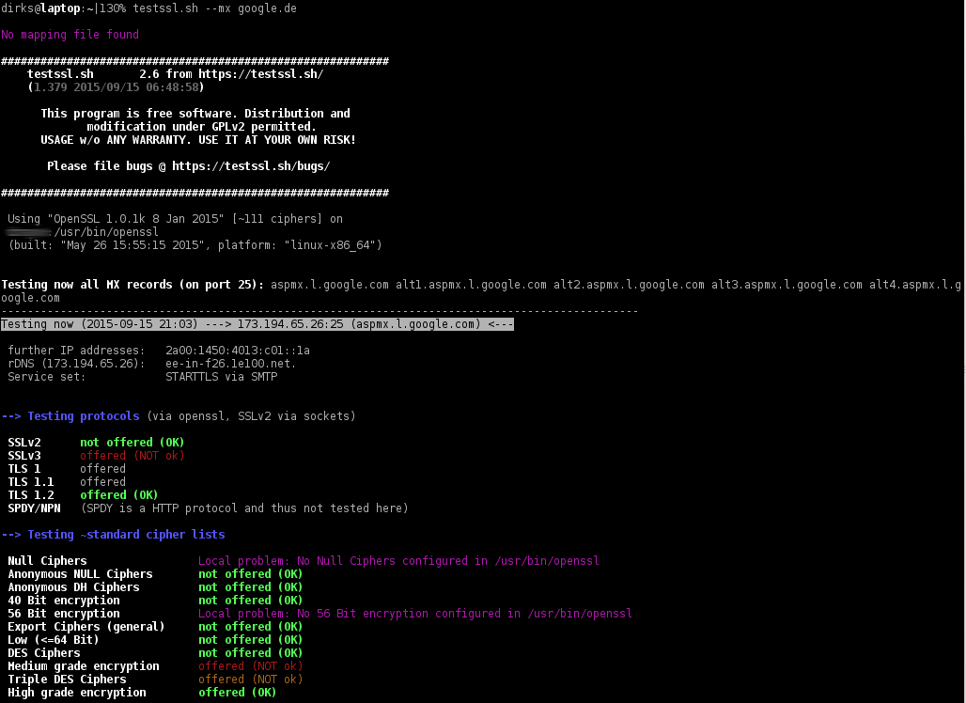
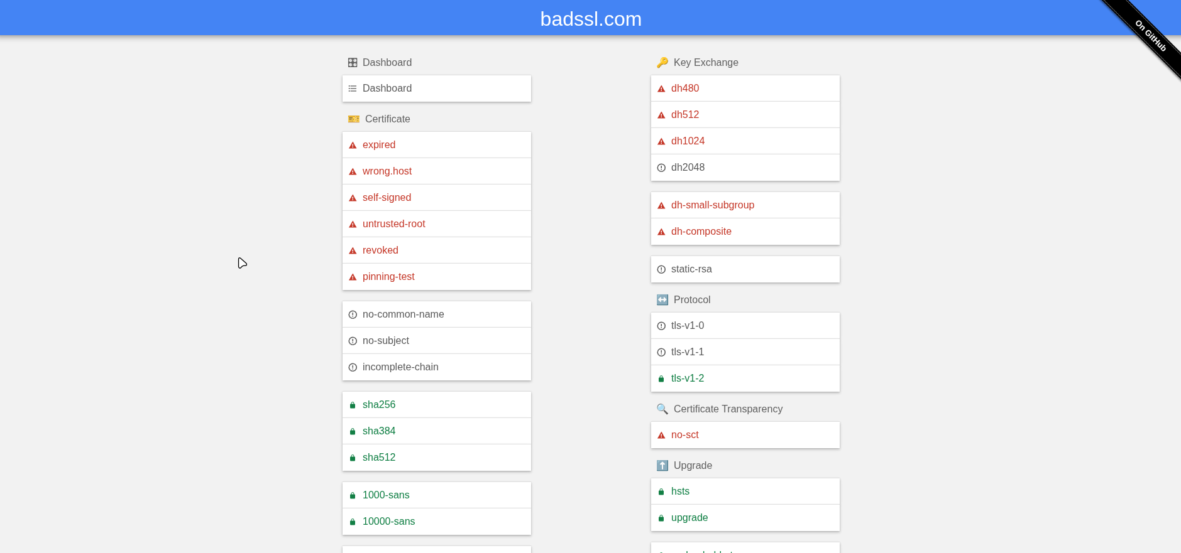
Current State of Email Security Testing
checktls.com
Testssl.sh
Badssl.com
Notes:
CheckTLS.com: paid service, a web-based way to test mail servers. active probing and reporting on connection details of tls.
Does this domain accept TLS for email delivery and how well is it configured? That’s relevant because server-to-server transport security is a key part of email security.
testssl.sh: command line tool for active scanning – actually sends requests to services checks TLS supported protocol versions, weak ciphers, and certificate issues. Can run against email-related ports like 465, 587, 993, so it helps validate TLS cryptographic params
BadSSL.com: when you visit a page it checks if your browser supports old insecure connections and would connect to smth dangerous expired subdomain, broken crypto ciphers
it’s a great reference for the idea of client-side security testing: not only whether TLS exists, but how the client reacts to degraded or invalid TLS. We apply that concept to email clients.

Slide 11
TLS-Strip attack
TLS
👾
Your email credentials are stolen!
How Is That Possible?

Slide 12
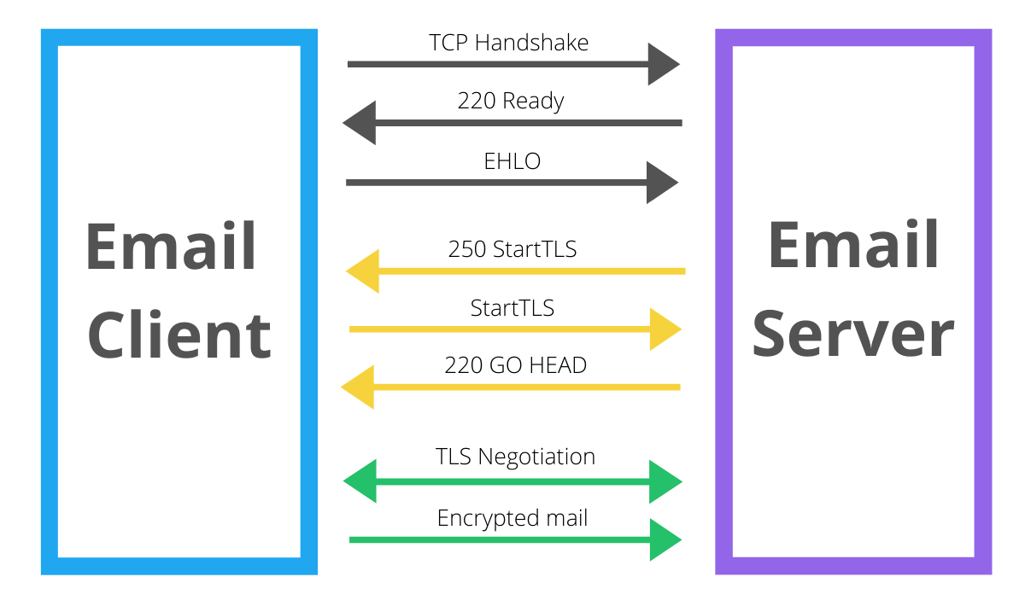
Vulnerability details: Opportunistic TLS
In plaintext!
Email client
Email server
An active attacker on the network can strip StartTLS and force no-TLS
SMTP protocol with StartTLS
if email server and client don’t explicitly disallow it
https://www.twilio.com/en-us/blog/insights/what-is-starttls

Slide 13
Security downgrade is possible if email server and client don’t explicitly disallow it
Vulnerable Servers
How many email servers would accept plaintext?

Slide 14
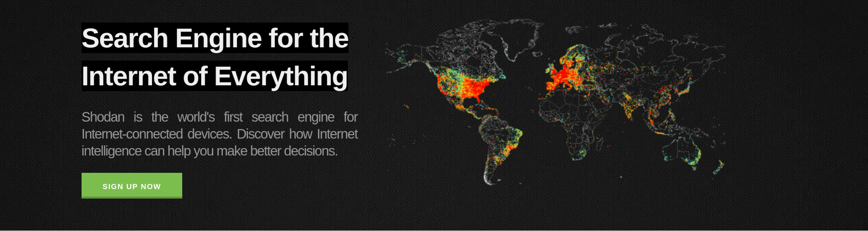
Shodan
A web-based search platform for Internet connected devices
We query Shodan API - https://api.shodan.io/shodan/host/count
Example query: port:587 ("ESMTP" OR "EHLO" OR "250-")
Shodan searches its database, we do not connect to actual servers on the Internet

Slide 15
Passive Measurement with Shodan
Idea: scan Internet for email servers that advertise plain auth
SMTP example:
1.Client requests capabilities from server
EHLO test.com
2.Server lists capabilities
250-mail.nsipmail.de
250-PIPELINING
250-SIZE 10240000
250-VRFY
250-ETRN
250-STARTTLS
250-AUTH PLAIN LOGIN
...
potentially effective before TLS
This does not guarantee server's vulnerability:
Client tries to login
C: AUTH PLAIN AGFsaWNlAHNlY3JldA==
Server rejects
S: 530 5.7.0 Must issue a STARTTLS command first

Slide 16
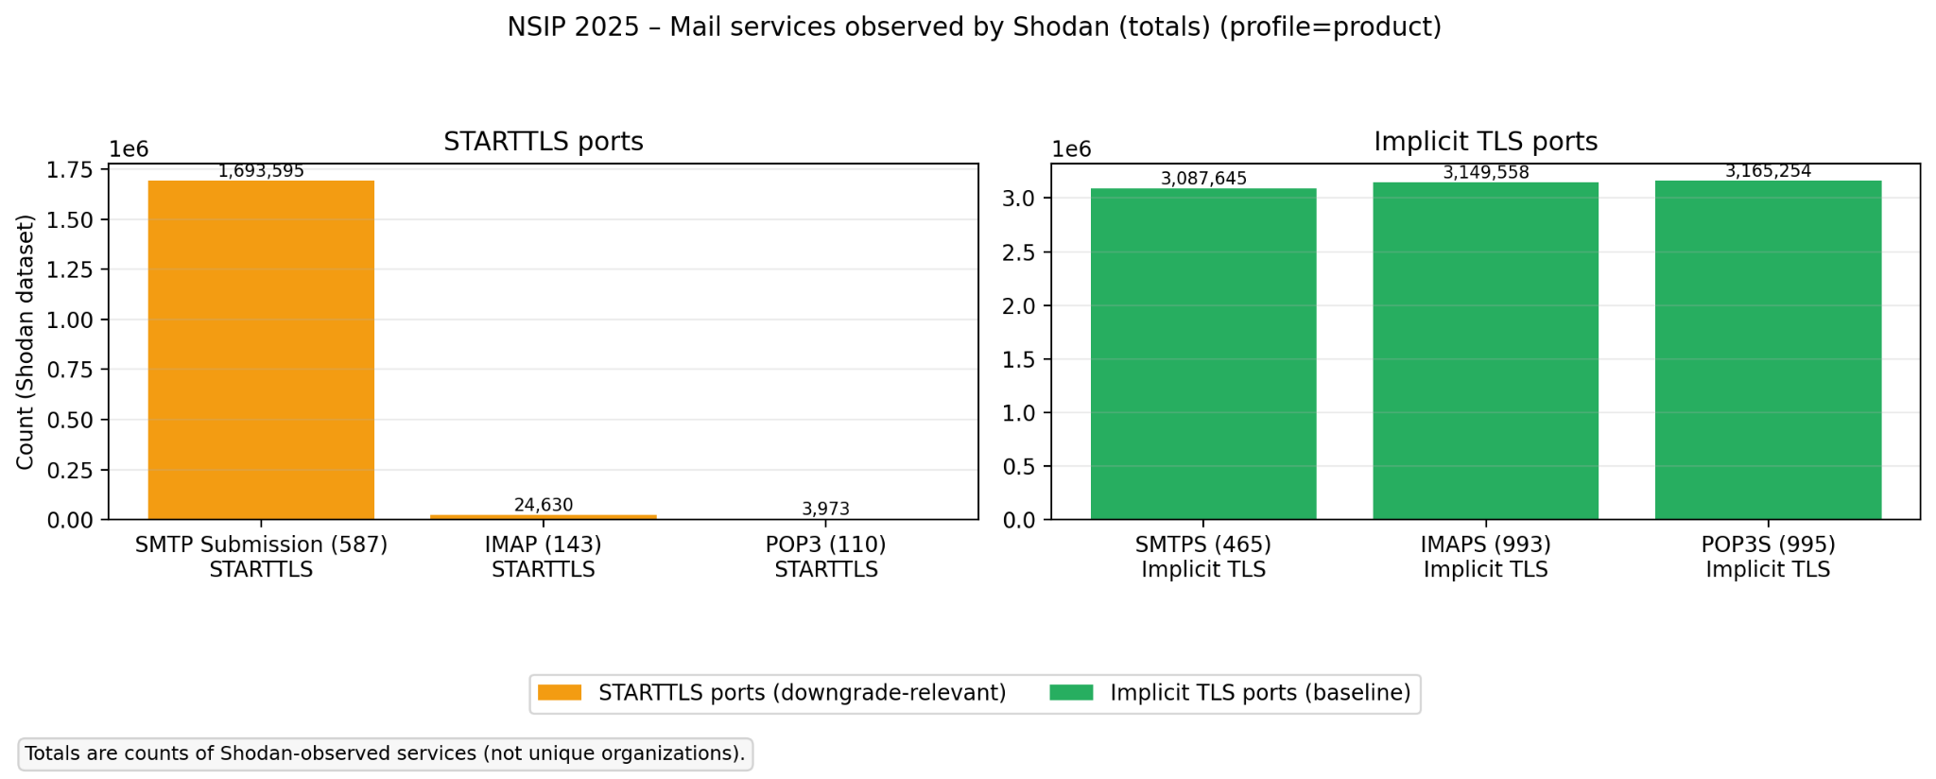
Passive Measurement with Shodan: results

Slide 17
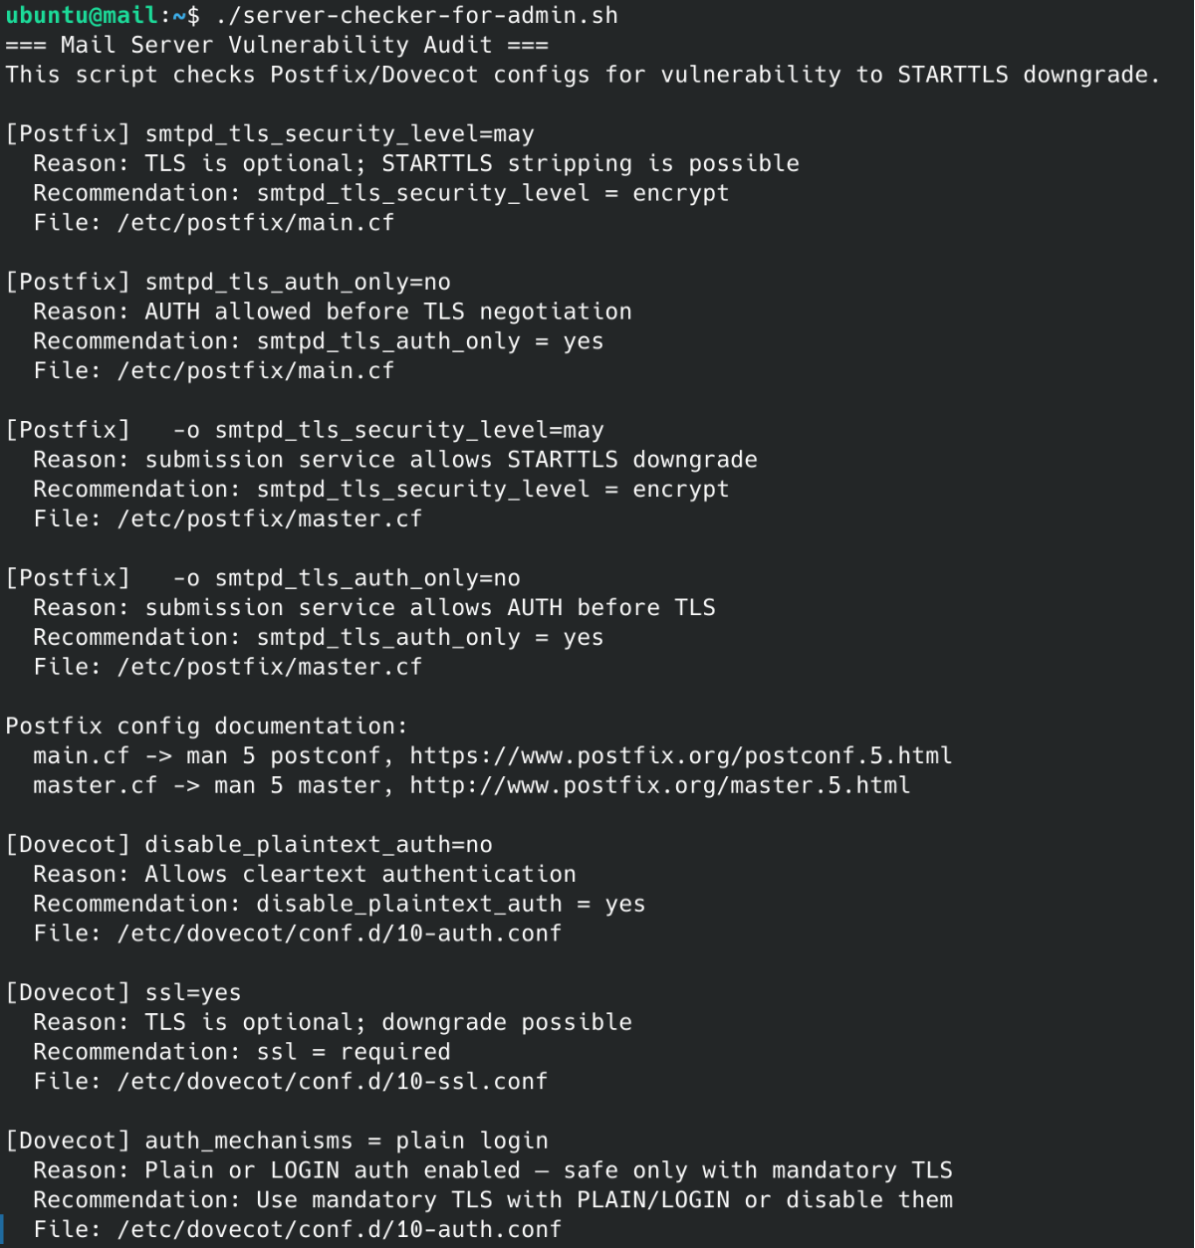
Email Server Configuration Scanner
Bash script
Postfix (SMTP) & Dovecot (IMAP, POP3)
Detects and issues warnings if:
TLS is optional instead of mandatory
insecure authentication options (plain, login)
Multiple config file support:
Dovecot: Handles split(conf.d/) and monolithic(dovecot.conf) configurations
Postfix: Supports main.cf and master.cf

Slide 18
Security downgrade is possible if email server and client don’t explicitly disallow it
Vulnerable Clients
How many email clients would authenticate in plaintext?

Slide 19
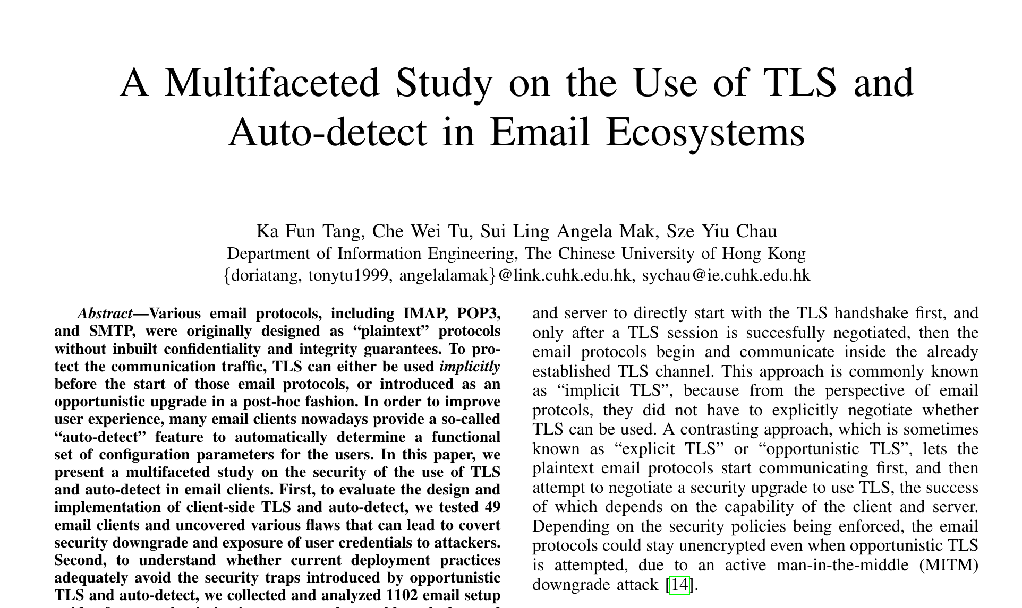
A Multifaceted Study on the Use of TLS and Auto-detect in Email Ecosystems (2025)
A study evaluating 49 real-world email clients' behavior in case of TLS disruptions
Methodology: lab setup with MiTM-proxy between email client and server
19/49 clients were found to be insecure
This motivates the need for users to be able to check their email client's security

Slide 20

A Multifaceted Study on the Use of TLS and Auto-detect in Email Ecosystems (2025)
Email client behavior*:
*can differ depending on email protocol and TLS downgrade test case
worst
best
Downgrade to no-TLS without notifying the user
Ask user permission to authenticate without TLS
Continuously attempt to reconnect
Do not authenticate without TLS
19 out of 49 tested clients may silently downgrade to no-TLS

Slide 21
A Multifaceted Study on the Use of TLS and Auto-detect in Email Ecosystems (2025)
Testing email client behavior: 4 variations of disruptions
T1:
"classic" strip StartTLS test
Client
MitM
Server
CAPA / EHLO
AUTH PLAIN
STARTTLS
AUTH PLAIN
T2: disrupt during TLS handshake
T3: disrupt after client selects STARTTLS
T4: disrupt ongoing TLS session

Slide 22
A Multifaceted Study on the Use of TLS and Auto-detect in Email Ecosystems (2025)
Testing email client behavior: 4 variations of disruptions
T3:
disrupt after client selects StartTLS
Client
MitM
Server
CAPA / EHLO
AUTH PLAIN
STARTTLS
STARTTLS
TLS not available
OK begin TLS negotiation

Slide 23
A Multifaceted Study on the Use of TLS and Auto-detect in Email Ecosystems (2025)
Testing email client behavior: 4 variations of disruptions
T2:
disrupt during TLS handshake
Client
MitM
Server
CAPA / EHLO
AUTH PLAIN
STARTTLS
STARTTLS
OK begin TLS negotiation
ClientHello
TLS handshake
TLS not available
ServerHello

Slide 24
A Multifaceted Study on the Use of TLS and Auto-detect in Email Ecosystems (2025)
Testing email client behavior: 4 variations of disruptions
T4:
disrupt ongoing TLS
session
Client
MitM
Server
CAPA / EHLO
AUTH PLAIN
STARTTLS
STARTTLS
OK begin TLS negotiation
...
TLS handshake
NOOP
Application Data
Exchange of encrypted data

Slide 25
Is your email client vulnerable?

Slide 26
Selftest Service
A way to test your email client in use.

Slide 27
What did we build?
Public, server-side mail client self-test for SMTP + IMAP
Tests whether a client can be coerced into plaintext authentication when TLS protection is disrupted
Implements baseline + T1–T4 behaviors (paper-inspired)

Slide 28
Why did we build it?
Paper setup assumes a MITM/lab environment (hard to reproduce for normal users)
We want a “click → configure account → observe result” workflow
No local proxy, no custom CA, no special network setup required

Slide 29
Demo

Slide 30
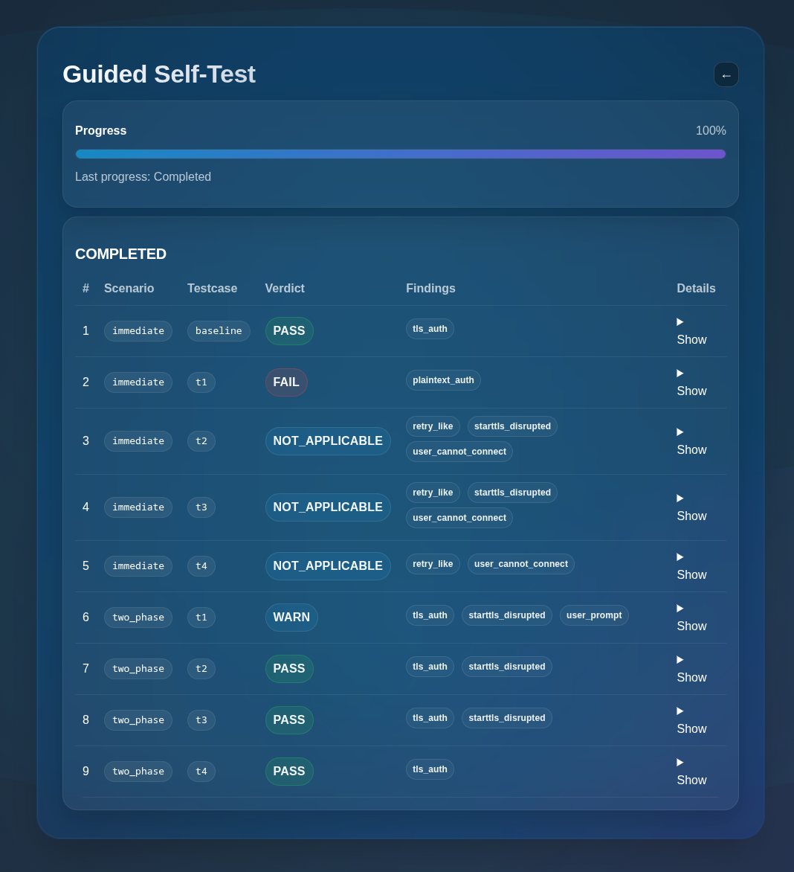
Result example

Slide 31
"Simulation" Diagram of T1
Client
MitM
Server
CAPA / EHLO
AUTH PLAIN
STARTTLS
AUTH PLAIN

Slide 32
"Simulation" Diagram of T1
Client
Server
CAPA / EHLO
AUTH PLAIN

Slide 33
Selftest-Service architecture
Server
143
selftest_server.py
reading mails
993
Protocol listeners
Core logic
Client
IMAPHandler
Mode engine
Baseline, t1-t4
587
sending mails
465
SMTPHandler
Session tagging
25
Event logger
read
mode
append events
443
Browser
State / files
mode.json
events.jsonl
read events
set mode
webui.py
Nginx

Slide 34
Selftest-Service architecture
Client
Mail Server (SMTP/IMAP)
writes
Event Log (JSONL)
reads
Mode Store (JSON)
Verdict Engine
writes
Browser
WebUI (FastAPI)

Slide 35
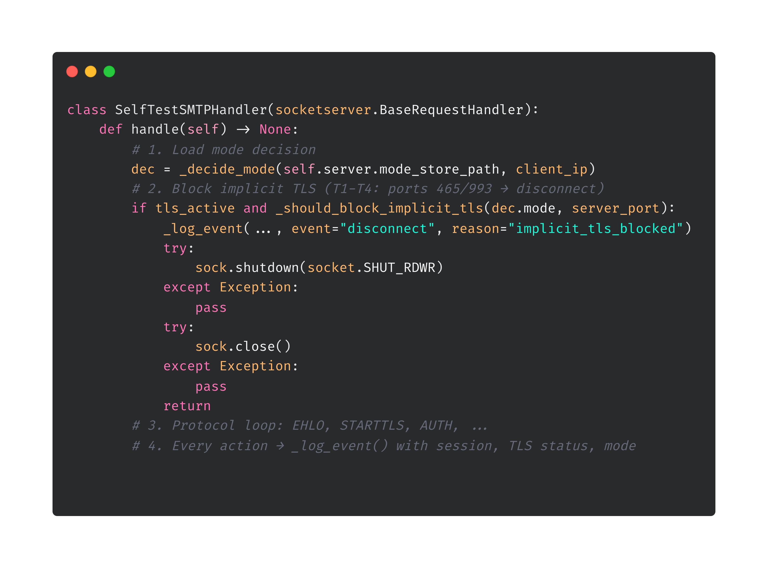
Handler Architecture – Code Overview
Notes:
If implicit TLS is detected, we log a disconnect event with the reason implicit_tls_blocked, shut down the socket, and return immediately.
Third — and this is where the main logic happens — the handler enters the protocol loop. This is where it processes SMTP commands like EHLO, STARTTLS, and AUTH. The behavior here changes depending on the active mode. For example, in T1 mode, the STARTTLS capability is simply not advertised in the EHLO response. I'll show this in detail on the next slide.
Fourth, every action throughout this process is logged via _log_event. Each event includes the session ID, the current TLS status, the active mode, and the protocol. These events are written to a JSONL file and later used by the WebUI to compute the test verdict.

Slide 36
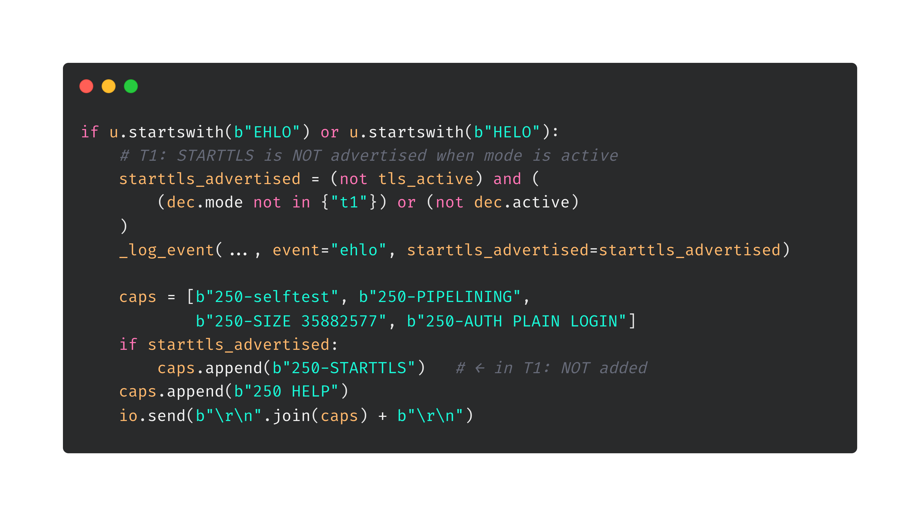
T1 Deep Dive – STARTTLS Capability Stripping (SMTP)
Baseline: Server responds with 250-STARTTLS → client upgrades to TLS → secure
T1 active: 250-STARTTLS is missing from the response → client "sees" no TLS option
Notes:
Not dec.active means that we are in two_phased mode which means before any disruption from the server side there has to be one successful connect so we cant strip the starttls because its needed in the first phase.
Pipelining is for clients to send multiple command at once
Maximal message length is 34mb
\r\n = CRLF (Carriage Return + Line Feed) so basically a break

Slide 37
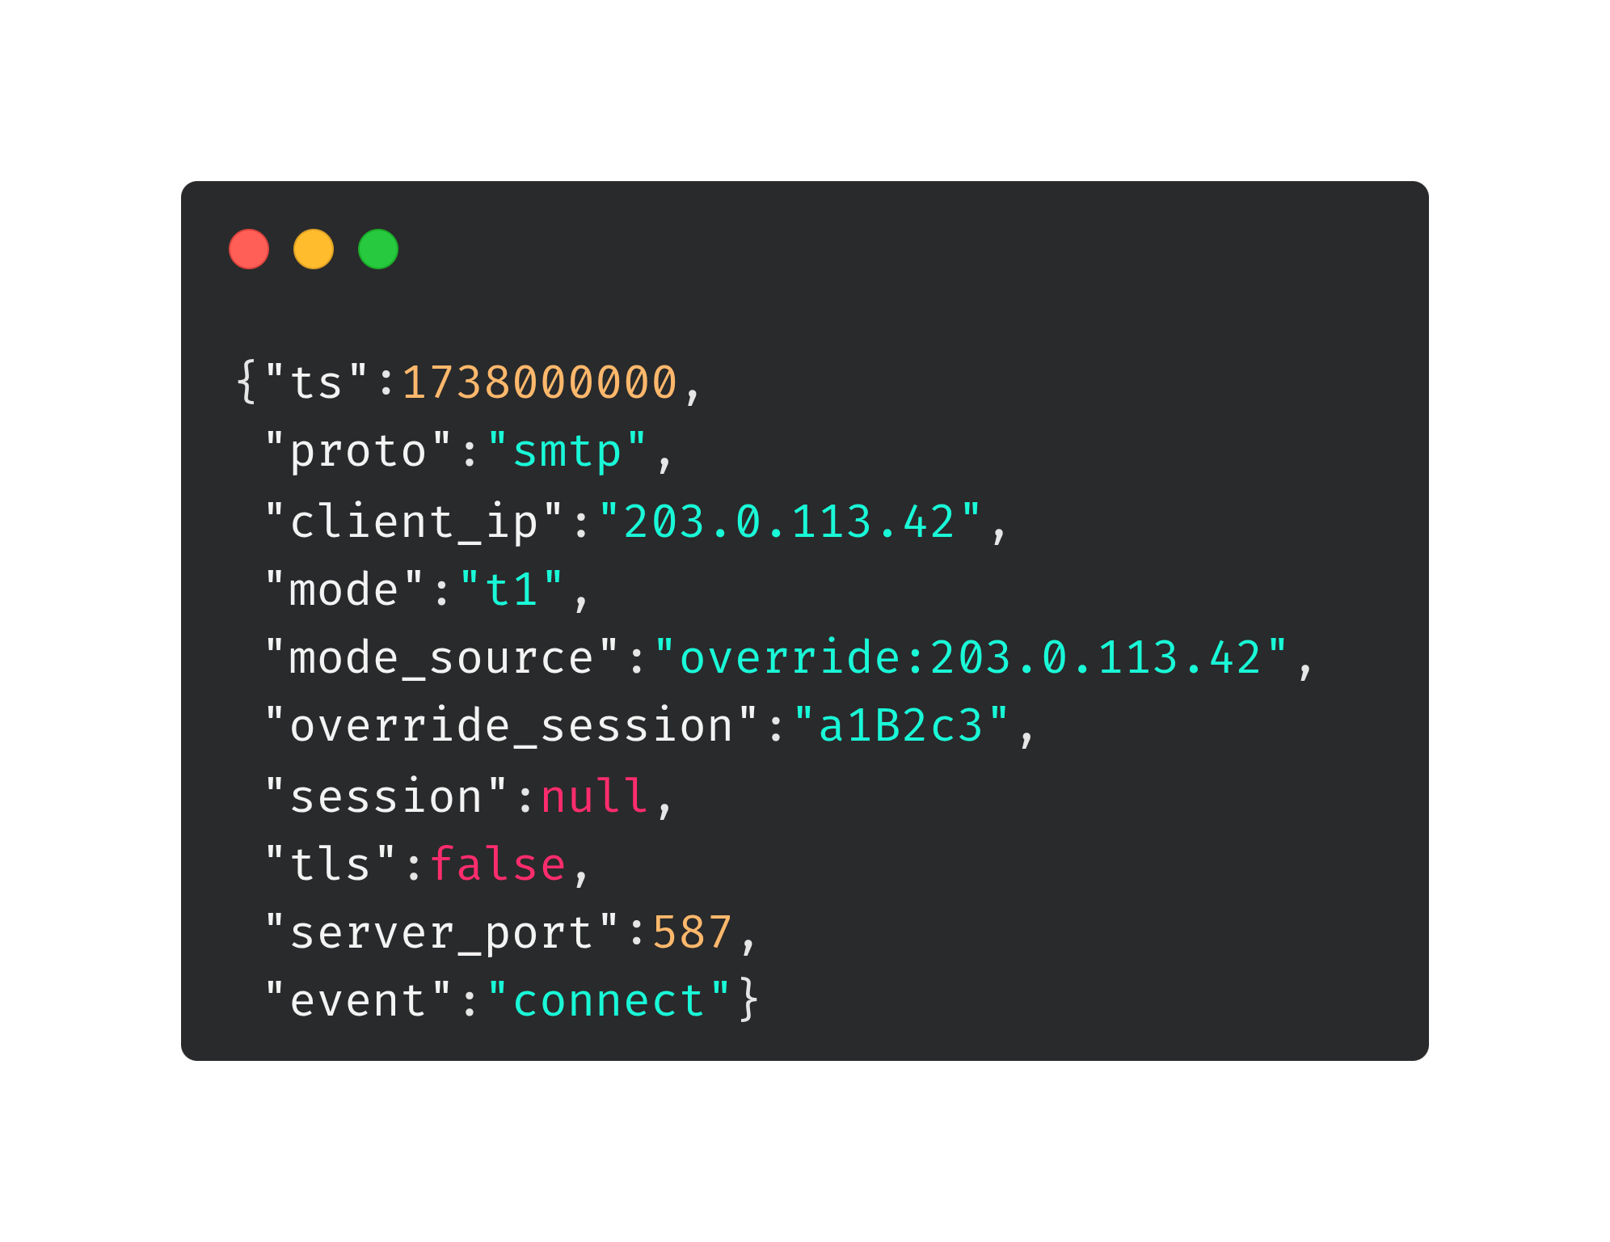
Event Logging – Structure & Examples
Example T1 event sequence (vulnerable client = FAIL):
Example T1 event sequence (secure client = INCONCLUSIVE):
# | Event | TLS | Meaning
1 | connect | false | Client connects on port 587
2 | ehlo | false | starttls_advertised: false (T1!)
3 | auth_command | false | ⚠️ Client sends AUTH without TLS
4 | disconnect | false | Connection closed
# | Event | TLS | Meaning
1 | connect | false | Client connects on port 587
2 | ehlo | false | starttls_advertised: false (T1!)
3 | disconnect | false | Client aborts (no STARTTLS → no login)

Slide 38
Possible Verdicts
PASS: Auth/login happened only with TLS (no plaintext credentials seen).
FAIL: Auth/login happened without TLS (plaintext credentials exposure).
INCONCLUSIVE: No auth/login observed (client aborted / got stuck / never reached auth).
WARN: Client showed a security prompt/downgrade warning (user-reported; no plaintext proven).
NOT_APPLICABLE: Test step couldn’t be executed (cannot connect; user-reported).
SKIPPED: Step was skipped in Guided mode
Notes:
FAIL
Plaintext credentials exposure detected
The service observed an authentication/login attempt with tls=false
Highest priority outcome (cannot be overridden by user reports)
PASS
No plaintext auth observed, and at least one authentication/login attempt succeeded under TLS (tls=true)
Indicates the client did not fall back to sending credentials in cleartext
INCONCLUSIVE
No authentication/login attempt was observed at all
Typical reasons: client aborts early, keeps retrying, or never reaches the auth stage (only probing capabilities / STARTTLS)
WARN
User-reported “security prompt / downgrade suggestion” in the client UI for this step/session
Used when we cannot reliably confirm plaintext exposure on the wire, but the client behavior indicates a risky or confusing downgrade situation
Only applies if FAIL did not already happen
NOT_APPLICABLE
User-reported “cannot connect” (step/session could not be executed)
Marks the result as not comparable / not measurable for that run
Only applies if FAIL did not already happen
SKIPPED
Guided step was explicitly skipped in the UI
Excluded from meaningful interpretation for that step

Slide 39
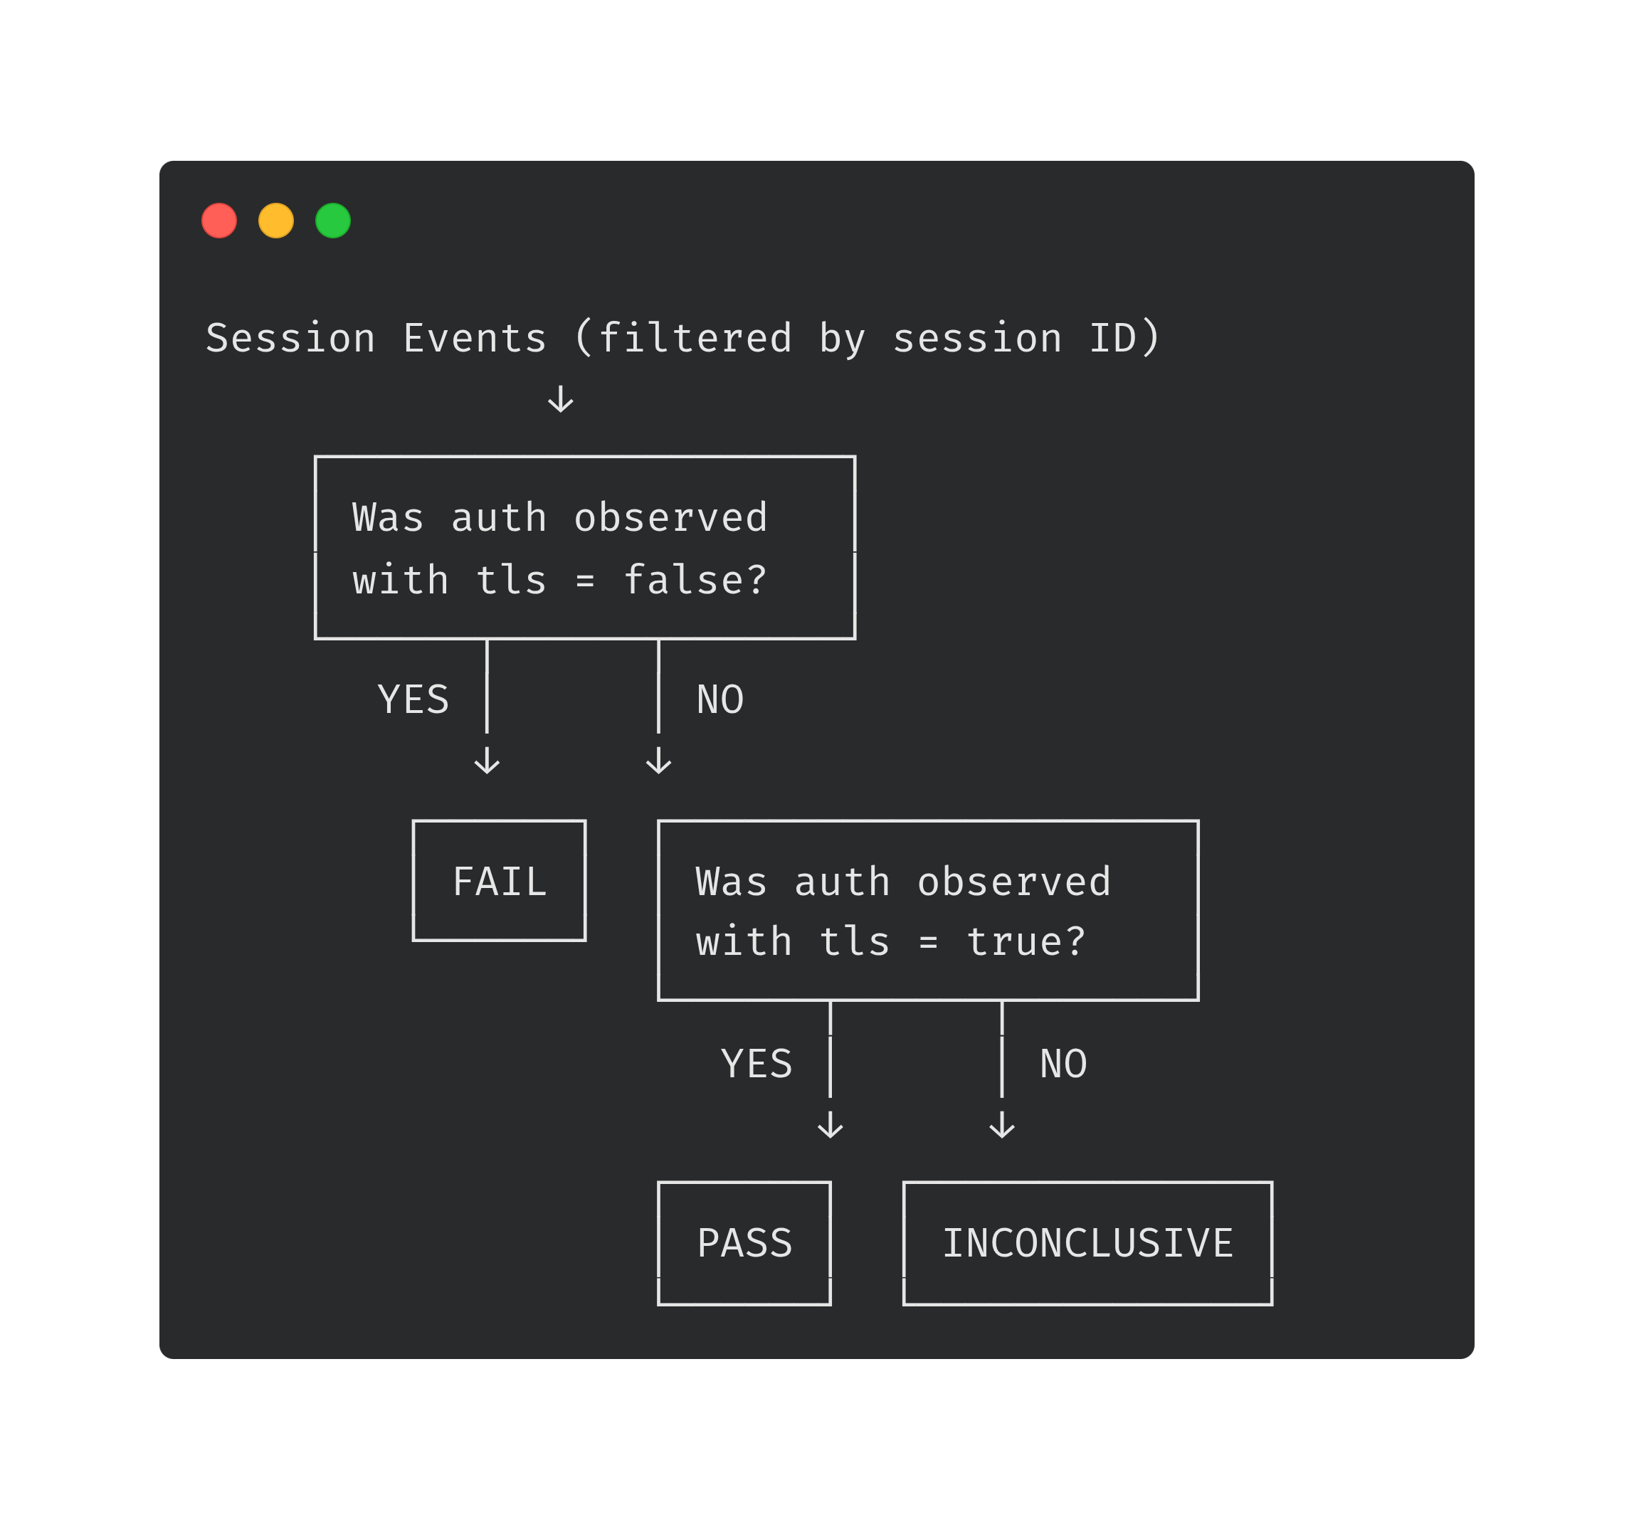
Event Evaluation – Verdict Computation
Signal | Source | Meaning
auth_plain count | Event log (SMTP + IMAP) | Auth attempts observed without TLS
auth_tls count | Event log (SMTP + IMAP) | Auth attempts observed with TLS active
retry_like | ≥6 connects, no auth | Client stuck in retry loop (keeps reconnecting)
starttls_refused_like | STARTTLS refused / dropped / wrap failed | Server disrupted TLS upgrade (testcase behavior)
User report: prompt | Manual user input | Client showed a security/downgrade prompt → WARN
User report: cannot_connect | Manual user input | Client could not connect at all → NOT_APPLICABLE

Slide 40
Technical Challenges & Design Decisions
Session encoding in username: test-SESSION@domain → server extracts session from username, since no other channel is available (no cookies/headers in SMTP/IMAP)
No real MITM required: The server itself simulates attack behavior → no mitmproxy on client side, no custom CA installation needed
Implicit TLS blocking: In T1–T4, ports 993/465 are immediately disconnected → forces clients onto STARTTLS ports where downgrade behavior is observable
Privacy-safe logging: Passwords are never logged, only username/session + TLS status
TTL-based overrides: Mode store with expiry per IP → no persistent state changes, automatic cleanup
Dual storage architecture: Event log (JSONL) is append-only and crash-safe
Persistent historical results: Guided run data and user-submitted session reports are never pruned
Notes:
JSONL: each protocol action is one line, never modified. Mode store (JSON) holds mutable state (overrides, guided runs, session reports) and uses atomic writes (temp file + rename) to prevent corruption.
Hisrotic: they serve as backing data for historical result pages. Only IP-based overrides are automatically cleaned up after TTL expiry. Trade-off: the mode store grows over time, but result URLs remain accessible indefinitely.

Slide 41
Pre-Authentication Session Binding Problem
Client connects (port 587) ← only IP known
Server sends: 220 ESMTP ← still only IP is known
Client: EHLO ← server responds with capabilities (T1 decision HERE)
Client: AUTH PLAIN <base64> ← session ID only available NOW (too late)
Problems:
NAT / shared IPs
CGNAT (mobile carriers)
VPN / proxy
Dynamic IP changes
Race condition
Notes:
ESMTP = Extended SMTP
<base64> username password
NAT: Multiple users behind the same router share one public IP. Our system can only have one active test override per IP — so if two people in the same office test at the same time, they interfere with each other.
CGNAT: Carrier-grade NAT is even worse — thousands of mobile users share a single public IP. If someone tests from a mobile hotspot, completely unrelated users have the same IP. There's no way to distinguish them before authentication.
VPN: If a user opens the WebUI from one network but their mail client routes through a VPN, the IPs don't match. The override was registered for the WebUI's IP, but the mail client connects from the VPN's IP — so the server doesn't find the session.
Dynamic IP: Some ISPs rotate IPs periodically. If the user's IP changes between starting the session in the WebUI and the mail client actually connecting, the override no longer matches. We mitigate this with a TTL countdown and an extend button, but can't prevent it.
RAce: If two users from the same IP start sessions at the same time, the second one overwrites the first — it's last-write-wins in the mode store. The first user's test silently switches to the second user's testcase mode.

Slide 42
Why we simulate (and why we don’t run a proxy/MITM)
Why no proxy on the client:
as little setup as possible
Why no proxy on the server (we simulate instead)
For our research question, what matters is the client’s view / decision point
A test server can create the same observable conditions by responding “as if a MITM was present”
Result: we can still measure whether the client ever sends AUTH/LOGIN without TLS
Could we still do it with a server-side proxy?
Build a relay proxy: client → proxy → real upstream mail server

Slide 43
Why no POP3?
“legacy” protocol
configuration effort for the user
Result: adding POP3 would likely reduce completion rate for a public self-test
For the initial service, IMAP + SMTP submission covers the most common real-world configurations
Notes:
User friction & configuration effort
Most modern clients default to IMAP, not POP3
POP3 setup is often hidden behind “manual / legacy” configuration
On mobile, POP3 support is frequently missing or inconsistent
Result: adding POP3 would likely reduce completion rate for a public self-test
Engineering effort vs. incremental value
Proper POP3 support requires a full protocol state machine
e.g., CAPA, STLS, USER/PASS, mailbox commands (STAT, LIST, RETR, …)
Also requires supporting 110 (STARTTLS) and 995 (implicit TLS) plus POP3-specific logging + WebUI guidance
For the initial service, IMAP + SMTP submission covers the most common real-world configurations
Measurement focus
Our core question is plaintext authentication fallback under TLS disruption
IMAP + SMTP already captures both:
incoming auth behavior (IMAP LOGIN)
outgoing auth behavior (SMTP AUTH)
POP3 can be added later as an extension once the IMAP/SMTP methodology is stable

Slide 44
Existing Tools?
 | Lynis | testssl.sh | postfix check | Our Server Checker
Focus | Full system audit | TLS handshake analysis | Config syntax | Config logic (auth + TLS)
Depth | Broad (OS, apps, network) | Broad (OS, apps, network) | Superficial | Deep (interdependencies)
Test logic | "Is the service running?" | "Is RC4 enabled?" | "Typo in config?" | "Is auth without TLS possible?"
Mail-specific | Minimal | STARTTLS check only | Postfix only | Postfix + Dovecot
Config source | Static files | Network probes | Static files | Runtime config (postconf -n, doveconf -n)
Cross-check | No | No | No | Yes (e.g., master.cf overrides main.cf)
Output | Compliance report | TLS details | Errors/warnings | Findings + fix recommendations
 | EAST | CheckTLS | BadSSL | Our Selftest Service
Target | Email client (MUA) | Email server (MTA) | Web browser | Email client (MUA)
Interface | CLI / local VM | Web form | Website | Web app + credentials
Audience | Researchers | Admins | End users | End users / Admins
STARTTLS stripping test | Yes (simulated) | No (passive only) | N/A | Yes (simulated, T1–T4)
Setup required | Local lab environment | None | None | None
Protocols tested | SMTP, IMAP, POP3 | SMTP (MTA-to-MTA) | HTTPS | SMTP, IMAP
Key limitation | Requires local proxy + CA | Tests server, not client | Web only, no email | IP-based session binding
Notes:
No public service exists that tests email clients for STARTTLS stripping vulnerability. EAST provides the underlying simulation technology but requires a local lab setup. CheckTLS only tests server-to-server encryption, not client behavior. BadSSL is browser-only. Our selftest service closes this gap by packaging the attack simulation as an accessible web service — no proxy installation or custom CA needed.
Existing tools are either too broad (Lynis audits the entire OS), too narrow (testssl.sh only checks crypto parameters), or too superficial (postfix check only catches syntax errors). None of them check the logical interaction between authentication and encryption settings — for example, whether Dovecot's disable_plaintext_auth = no combined with ssl = yes (instead of required) creates a downgrade path. Our script specifically targets these interdependencies across both Postfix and Dovecot, using runtime configuration output rather than parsing static files.

Slide 45
Summary and Evaluation
Capabilities
Realistic Attack Simulation
Accessible to All Users
Granular Diagnostics
Server-Checker: Static Configuration Audit
Limitations
IP-Based Mode Selection
Destination Server, Not Proxy
Protocol Scope
Server Checker: No Runtime Verification
Notes:
Capabilities
Realistic Attack Simulation: Automatically simulates specific adversary models (T1–T4) to trigger STARTTLS stripping, dropping, and disruption.
Accessible to All Users: "Guided Mode" provides a wizard-style interface that requires no technical knowledge to verify client security.
Granular Diagnostics: Captures and correlates protocol-level events (Connect, EHLO, AUTH) to pinpoint exactly where a client fails (e.g., sending plaintext credentials).
Static Configuration Audit: Proactively scans local Postfix and Dovecot configuration files to detect insecure settings (e.g., optional TLS, plaintext auth) and provides actionable fix recommendations.
Limitations
IP-Based Mode Selection: Initial connection handling relies on client IP addresses, which can lead to conflicts or race conditions for users sharing the same network (NAT) before they authenticate.
Destination Server, Not Proxy: Functions as a mail server endpoint; users must actively configure a new account rather than testing their existing provider connection transparently.
Protocol Scope: Primarily targets Opportunistic TLS (STARTTLS) downgrades; does not fully evaluate complex certificate validation (e.g., DANE/MTA-STS) or strict Implicit TLS issues.
No Runtime Verification: Relies solely on parsing config files on disk; cannot validate the actual running service state, effective parameters (e.g., complex includes), or network-level accessibility.

Slide 46
Additional Slides

Slide 47
Current Security State of Email
MTA-STS (Mail Transfer Agent Strict Transport Security)
Mechanism: Enforces TLS via an HTTPS-based policy file and a DNS TXT record to prevent downgrade attacks.
Trust Model: Relies on the traditional Public Key Infrastructure (PKI) and trusted Certificate Authorities (CAs).
DANE (DNS-based Authentication of Named Entities)
Mechanism: Binds TLS certificates/keys directly to DNS records (TLSA) to verify the recipient’s identity
Trust Model: Requires DNSSEC to create a cryptographically secured chain of trust within the DNS itself.
Adoption vs. Risk: While major providers (Google/MS) enforce these standards for high volumes, Opportunistic STARTTLS remains a global fallback; without MTA-STS/DANE, connections are still vulnerable to "STRIPTLS" downgrade attacks.

Slide 48
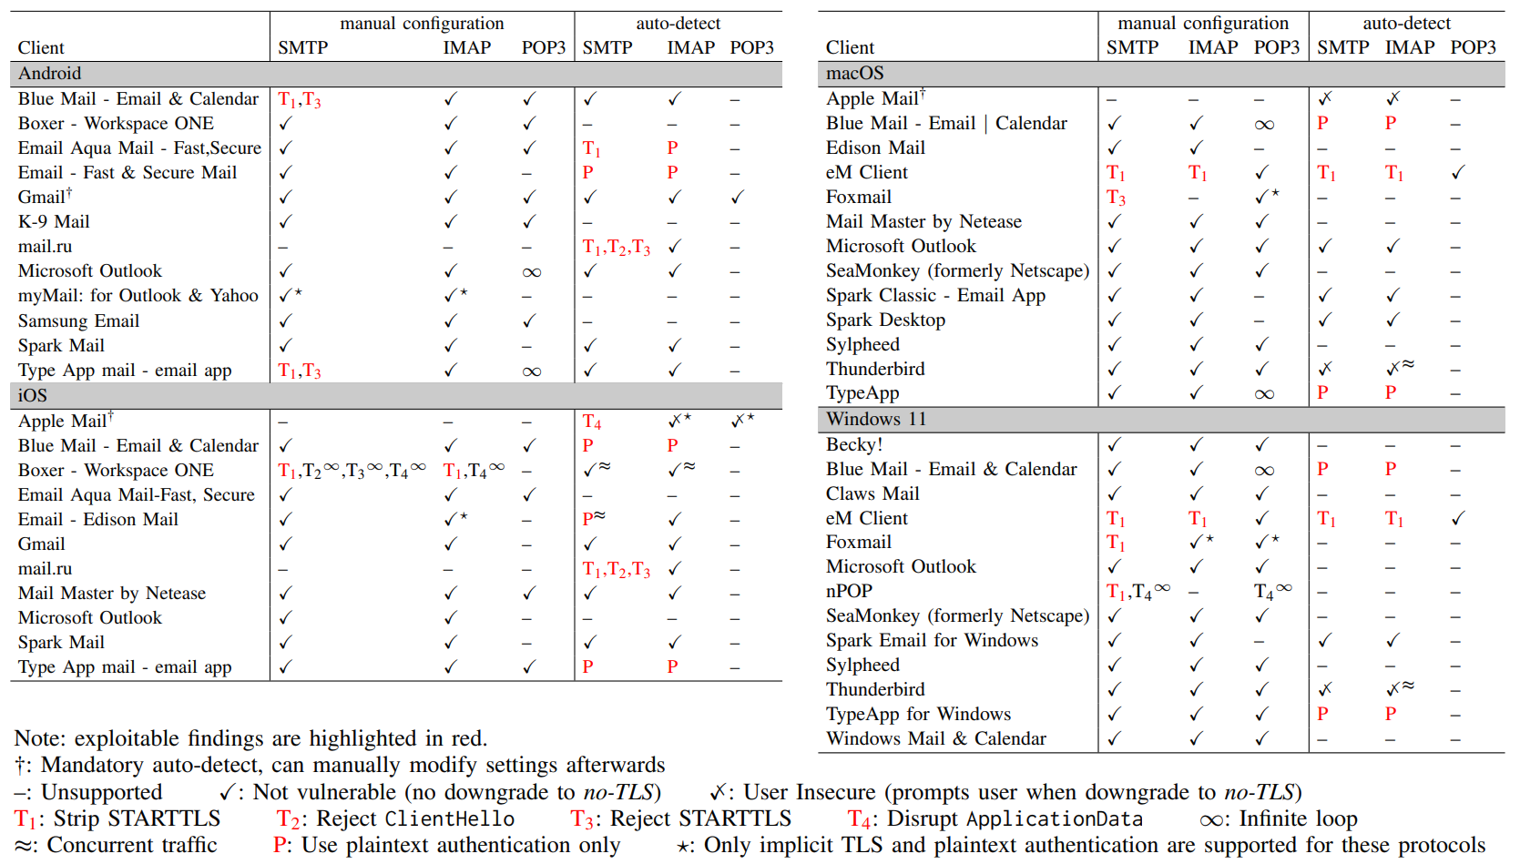
A Multifaceted Study on the Use of TLS and Auto-detect in Email Ecosystems (2025)

Slide 49
Future directions
Selftest-Service:
POP3 extension
Stronger session isolation + user accounts
Lab-grade “real MITM” + real mailbox
Admin/server-side test tool
CLI/script for mail admins to test their own SMTP/IMAP/POP3 configuration against T1–T4 downgrade conditions
Manual vs autodetect behavior
Systematically investigate differences between manual configuration and autodiscovery-driven configuration paths.

